Slide 1
Mohammed S Shurrab
devmsh
CTO @ Unit One Group

Slide 2
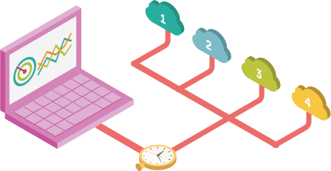
CDN

Slide 3
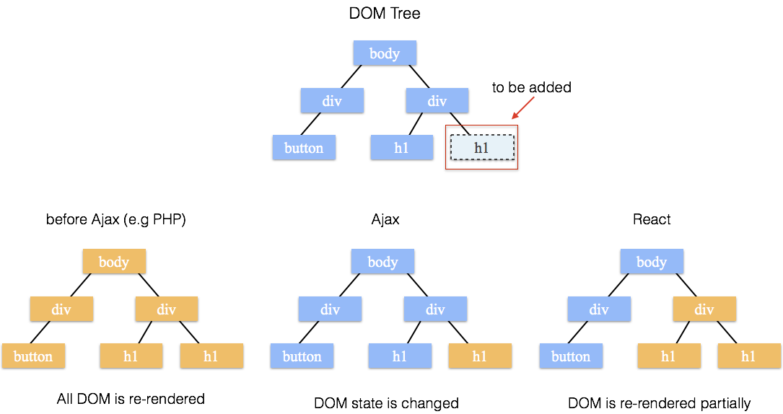
Virtual DOM

Slide 4
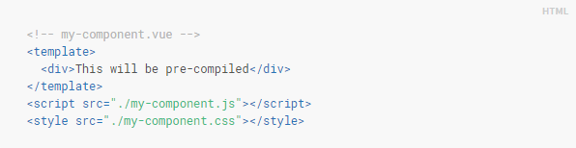
Single file vs. external scripts and styles
Separation of concerns vs. Separation of types
You still able to separate the files if you like!
Component become more cohesive and maintainable

Slide 5
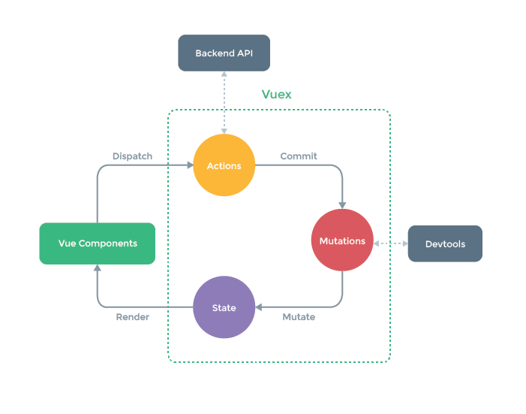
State Store Management vs. Global Events
Global Events is simple and can be used for little cross component communication.
State Store is complex but reliable for big projects and allow for easier debugging, persistent store, and many other features.

